Slide 1
Machine Learning / Tree based methods

Slide 2
Decision Trees
Regression

Slide 3
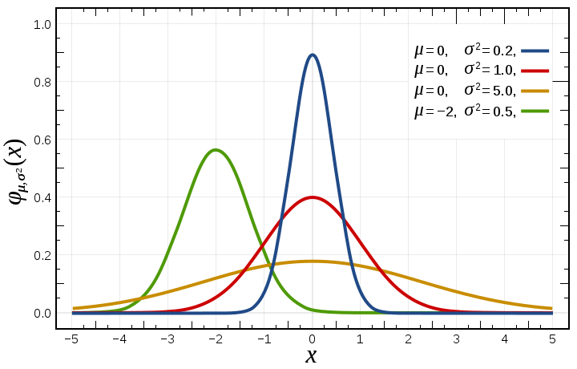
Variance

Slide 4
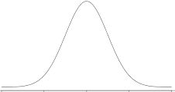
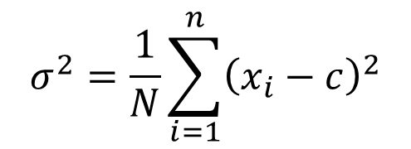
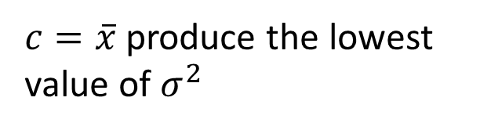
Variance
$$σ^{2}=\frac{1}{N}\sum_{i=1}^{n}{{\left(x_{i}−c\right)}^{2}}$$
$c=\overline{x}$ produce the lowest value of $σ^{2}$

Slide 5
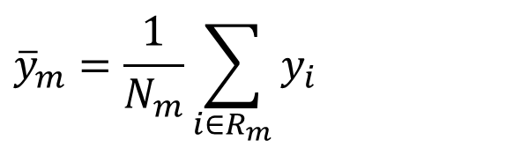




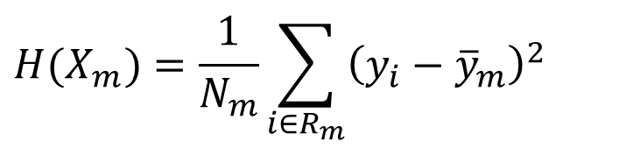
Domain partitioning
$$f(x_{1},x_{2})=y$$
$${\overline{y}}_{m}=\frac{1}{N_{m}}\sum_{i∈R_{m}}{y_{i}}$$
Root node
$${\overline{y}}_{3}=6.74$$
$${\overline{y}}_{1}=5.11$$
$$H(X_{m})=\frac{1}{N_{m}}\sum_{i∈R_{m}}{{\left(y_{i}−{\overline{y}}_{m}\right)}^{2} }$$
Internal node
$${\overline{y}}_{2}=6.0$$
Leaf
Leaf
Leaf

Slide 6
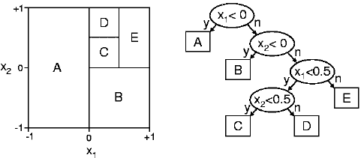
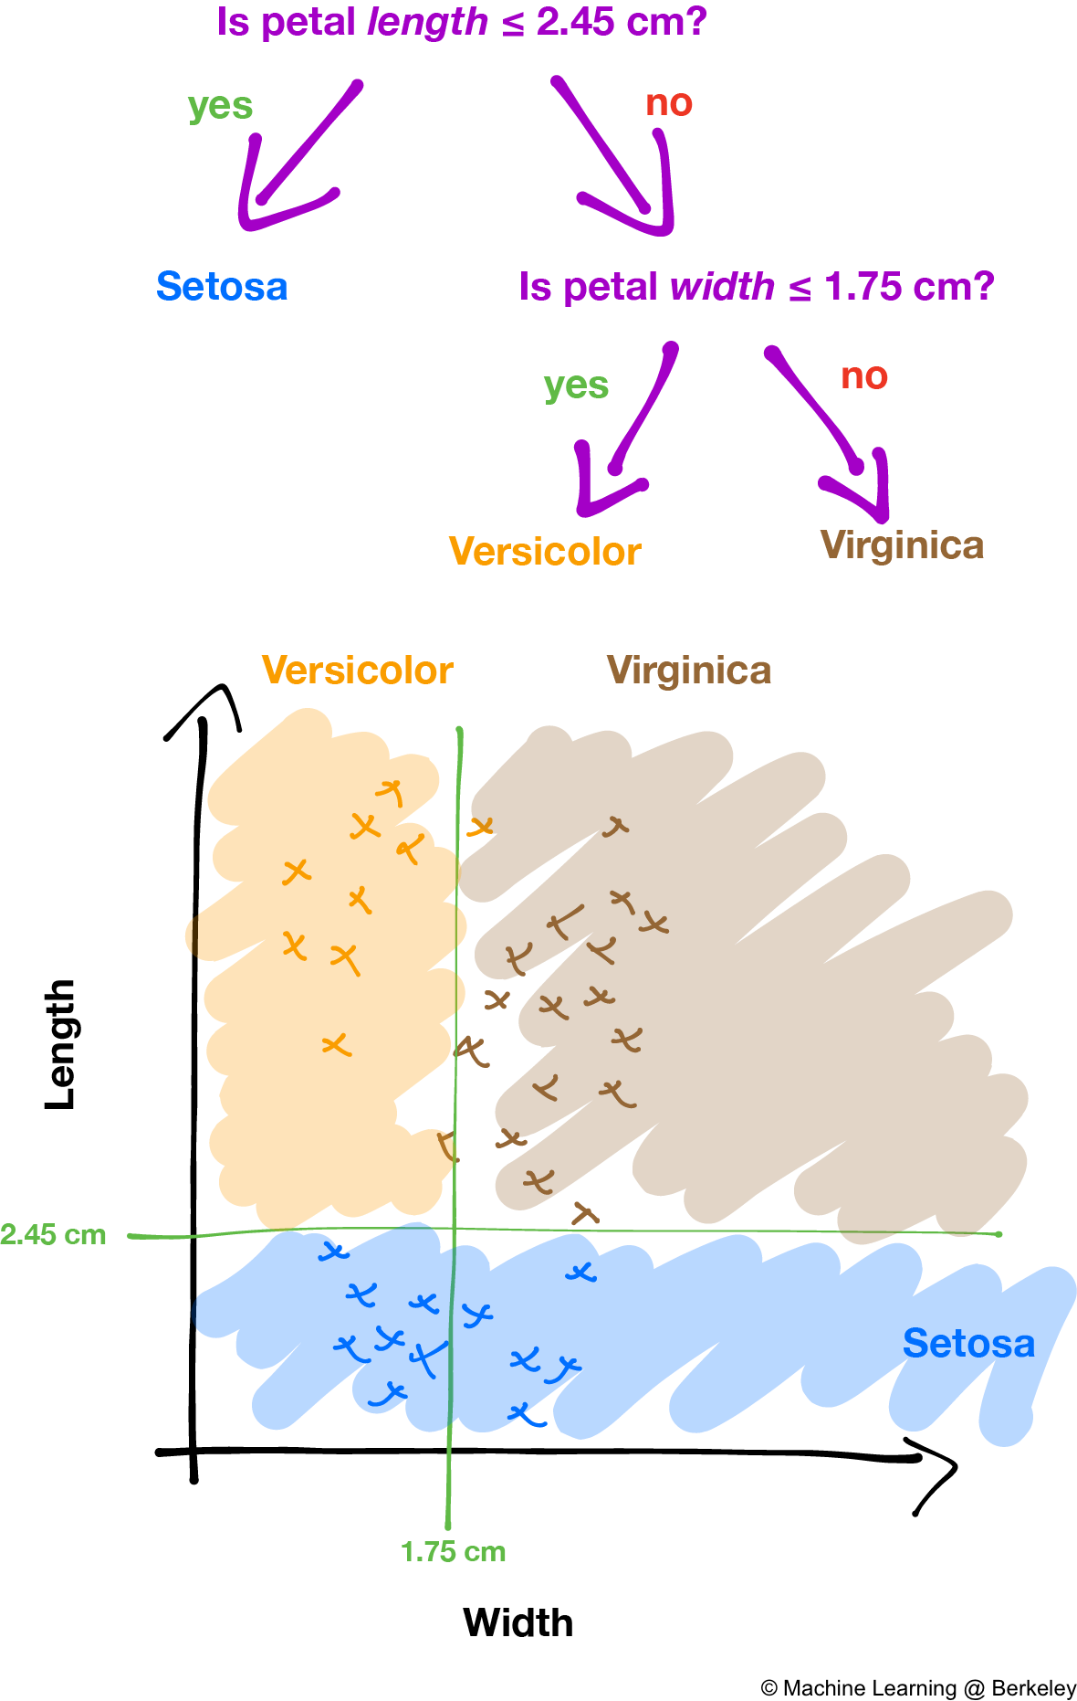

Slide 7
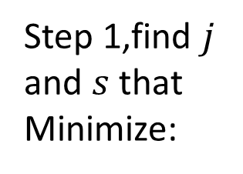
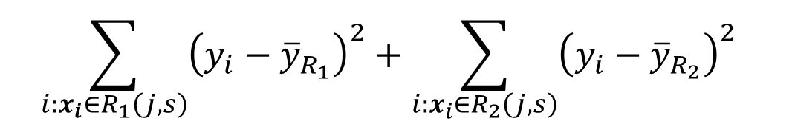



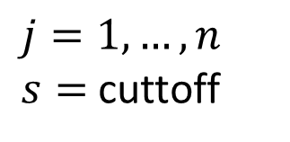
$$R_{1}$$
$$\overline{X}$$
$$R_{2}$$
Fit
Step 1,find $j$ and $s$ that Minimize:
$$\sum_{i:x_{i}∈R_{1}\left(j,s\right)}{{\left(y_{i}−{\overline{y}}_{R_{1}}\right)}^{2}+\sum_{i:x_{i}∈R_{2}\left(j,s\right)}{{\left(y_{i}−{\overline{y}}_{R_{2}}\right)}^{2}} }$$
$j=1,…, n$
$s=$ cuttoff
Notes:
$n=$ Number of predictor variables

Slide 8
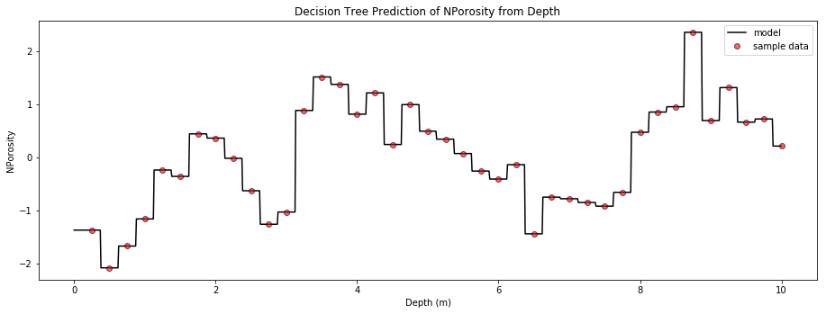
https://github.com/GeostatsGuy/PythonNumericalDemos/blob/master/SubsurfaceDataAnalytics_PolygonalRegression.ipynb

Slide 9
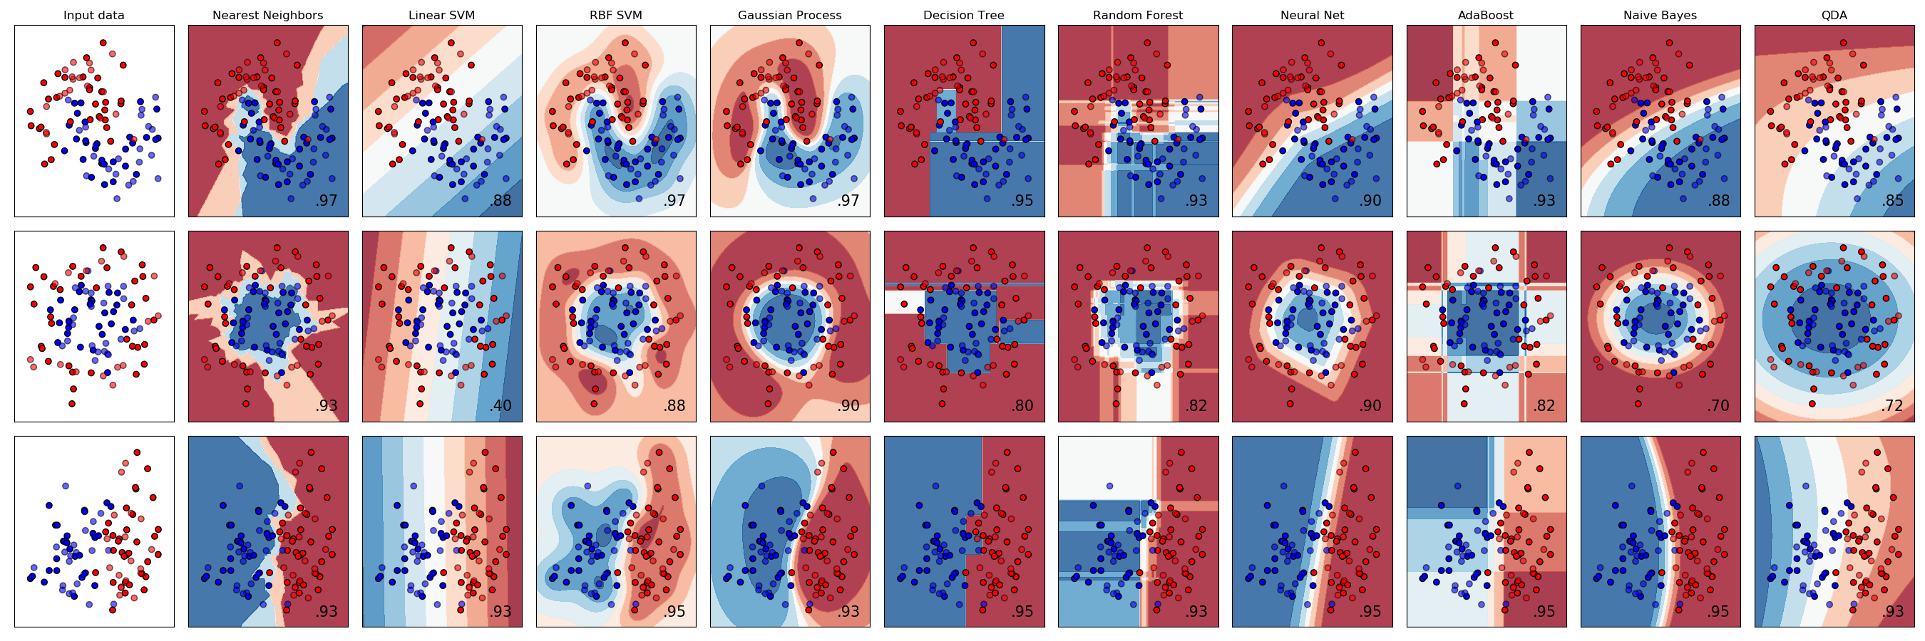
Decision Trees
Classification

Slide 10
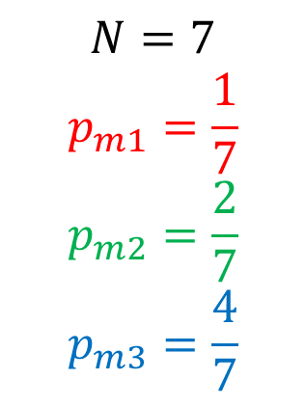
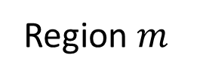
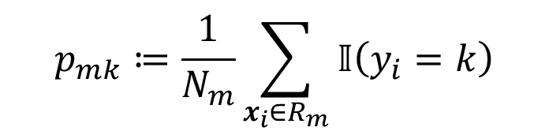
Proportions
Region $m$
$$p_{mk}≔\frac{1}{N_{m}}\sum_{x_{i}∈R_{m}}{𝕀\left(y_{i}=k\right)}$$
$$N=7$$
$$p_{m1}=\frac{1}{7}$$
$$p_{m2}=\frac{2}{7}$$
$$p_{m3}=\frac{4}{7}$$
https://scikit-learn.org/stable/modules/tree.html#classification-criteria
p. 311-313, Hastie, 2014

Slide 11
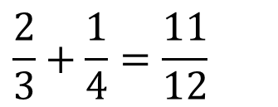


Impurity functions. Misclassification
Region $m$
$$H\left(X_{m}\right)=1−\max_{k}{(p_{mk})}$$
Misclassification
$$s_{1}$$
$$\frac{2}{3}+\frac{1}{4}=\frac{11}{12}$$
https://scikit-learn.org/stable/modules/tree.html#classification-criteria
p. 311-313, Hastie, 2014

Slide 12
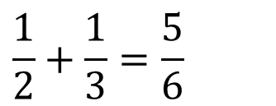

Impurity functions. Misclassification
Region $m$
$$H\left(X_{m}\right)=1−\max_{k}{(p_{mk})}$$
Misclassification
$$s_{2}$$
$$\frac{2}{3}+\frac{1}{4}=\frac{11}{12}$$
$$\frac{1}{2}+\frac{1}{3}=\frac{5}{6}$$
https://scikit-learn.org/stable/modules/tree.html#classification-criteria
p. 311-313, Hastie, 2014

Slide 13

Impurity functions. Misclassification
Region $m$
$$H\left(X_{m}\right)=1−\max_{k}{(p_{mk})}$$
Misclassification
$$s_{3}$$
$$\frac{2}{3}+\frac{1}{4}=\frac{11}{12}$$
$$\frac{1}{2}+\frac{1}{3}=\frac{5}{6}$$
https://scikit-learn.org/stable/modules/tree.html#classification-criteria
p. 311-313, Hastie, 2014

Slide 14
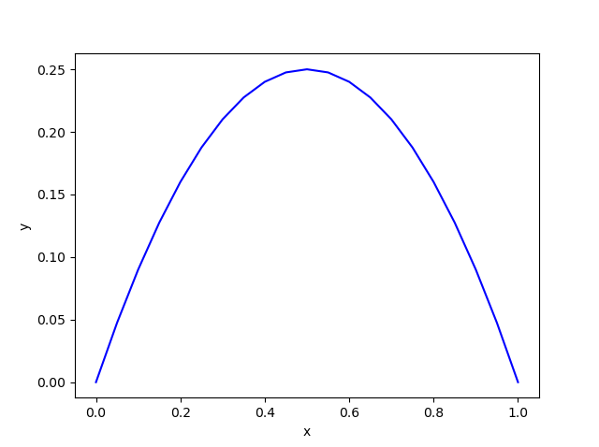
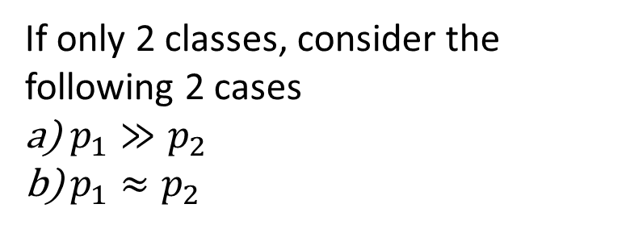
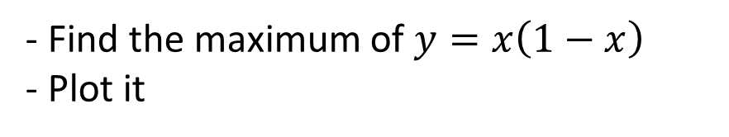
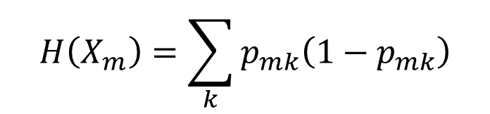
Impurity functions. Gini Index
Region $m$
$$H\left(X_{m}\right)=\sum_{k}{p_{mk}\left(1−p_{mk}\right)}$$
- Find the maximum of $y=x\left(1−x\right)$
- Plot it
If only 2 classes, consider the following 2 cases
$p_{1}≫p_{2}$
$p_{1}≈p_{2}$
https://scikit-learn.org/stable/modules/tree.html#classification-criteria
p. 311-313, Hastie, 2014
Notes:
Maximo. $y\left(0.5\right)=0.25$
x = np.linspace(0,1, 21)
y=x*(1-x)
plt.plot(x, y, 'b-')
plt.axvline(0.5)
plt.show()

Slide 15
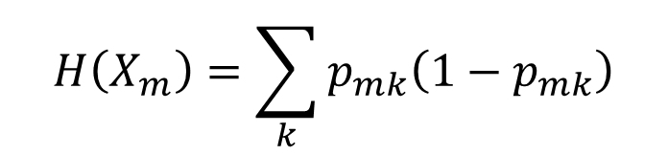
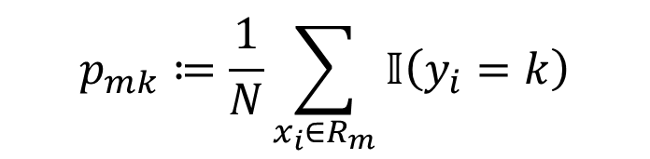

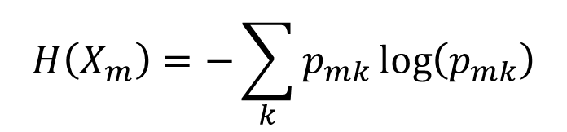
Impurity functions
Region $m$
$$p_{mk}≔\frac{1}{N}\sum_{x_{i}∈R_{m}}{𝕀\left(y_{i}=k\right)}$$
$$H\left(X_{m}\right)=1−\max_{k}{(p_{mk})}$$
Misclassification
$$H\left(X_{m}\right)=\sum_{k}{p_{mk}\left(1−p_{mk}\right)}$$
Gini Index
$$H\left(X_{m}\right)=−\sum_{k}{p_{mk}\log\left(p_{mk}\right)}$$
Entropy
https://scikit-learn.org/stable/modules/tree.html#classification-criteria
p. 311-313, Hastie, 2014

Slide 16
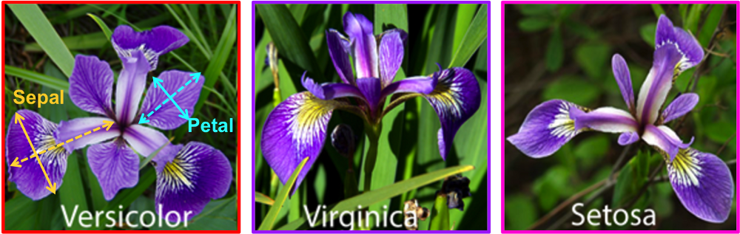
Iris dataset
Notes:
[Setosa, Versicolor, Virginica]
Compute the Gini index for the green box

Slide 17
Ensemble methods

Slide 18
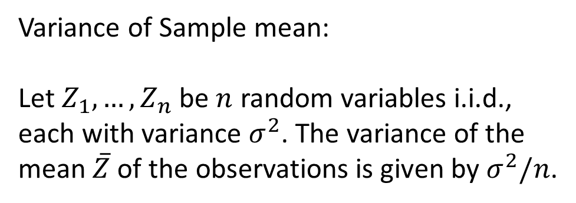
Bagging (Sampling with replacement)
Bootstraping
Variance of Sample mean:
Let $Z_{1},…,Z_{n}$ be $n$ random variables i.i.d., each with variance $σ^{2}$. The variance of the mean $\overline{Z}$ of the observations is given by $σ^{2}/n$.
https://scikit-learn.org/stable/modules/generated/sklearn.ensemble.BaggingClassifier.html
https://scikit-learn.org/stable/modules/generated/sklearn.ensemble.BaggingRegressor.html
Notes:
https://www.econometrics-with-r.org/2-2-RSATDOSA.html
http://pages.stat.wisc.edu/~yandell/st571/R/append5.pdf

Slide 19
Bagging (Sampling with replacement)
Bootstraping
Classification:
- Majority vote

Slide 20
Random Forests

Slide 21
Boosting
Sequentially
Fewer splits (stumps)
Video_Trevor Hastie - Gradient Boosting Machine Learning
Notes:
https://www.analyticsvidhya.com/blog/2018/09/an-end-to-end-guide-to-understand-the-math-behind-xgboost/
http://www.ccs.neu.edu/home/vip/teach/MLcourse/4_boosting/slides/gradient_boosting.pdf
https://statweb.stanford.edu/~jhf/ftp/trebst.pdf

Slide 22
XGBoost
https://xgboost.readthedocs.io/en/latest/tutorials/model.html
https://xgboost.ai/
https://www.kdd.org/kdd2016/papers/files/rfp0697-chenAemb.pdf
See also
https://github.com/Microsoft/LightGBM
https://catboost.ai/
Notes:
https://www.analyticsvidhya.com/blog/2018/09/an-end-to-end-guide-to-understand-the-math-behind-xgboost/
https://machinelearningmastery.com/gentle-introduction-xgboost-applied-machine-learning/
https://www.kaggle.com/c/LANL-Earthquake-Prediction/discussion/89909

Slide 23

Machine Learning Overview
Regression
Classification
Size of shoes $x$ to classify individuals' sex ($y$) Male or Female
$f:x→y$

Slide 24
Testing and validating
Training set
Test set
Ref. Aurelien, 2019, ch. 2, Testing and Validating

Slide 25
Testing and validating
Validation set
Ref. Aurelien, 2019, ch. 2, Testing and Validating

Slide 26

1D Decision Trees (Classification)
Train set
Validation (data)set
Cutoff
Test (data)set
$$ℝ$$
Train, Test, & Validation Sets explained
Regression Trees
The estimation problem in a particular zone can be done with any interpolation procedure but it is usually accomplished computing the mean values

Slide 27
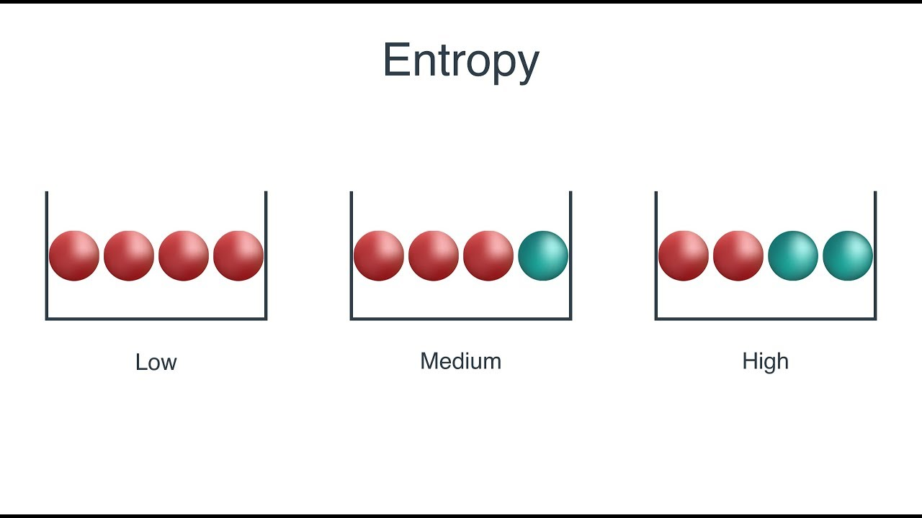

Slide 29
Tree, Random Forests, Bagged Trees, AdaBoost, XGBoost

Slide 31
https://github.com/GeostatsGuy/PythonNumericalDemos/blob/master/DT_Demo.ipynb Decision tree
https://github.com/GeostatsGuy/PythonNumericalDemos/blob/master/SubsurfaceDataAnalytics_DecisionTree.ipynb
https://github.com/GeostatsGuy/PythonNumericalDemos/blob/master/SubsurfaceDataAnalytics_Gradient_Boosting_Simple.ipynb
https://github.com/GeostatsGuy/PythonNumericalDemos/blob/master/SubsurfaceDataAnalytics_Gradient_Boosting.ipynb

Slide 32
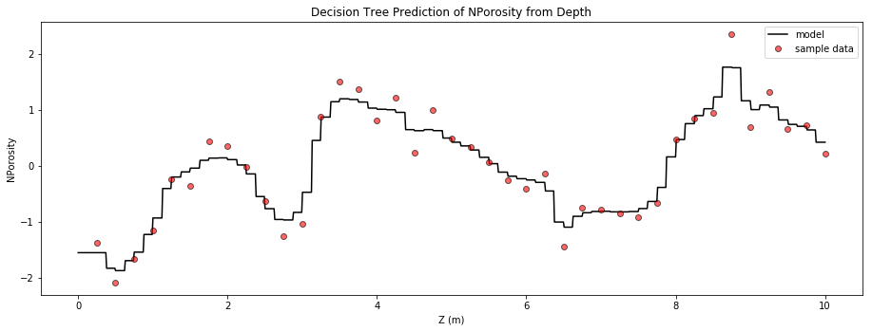
Random Forest
https://github.com/GeostatsGuy/PythonNumericalDemos/blob/master/SubsurfaceDataAnalytics_PolygonalRegression.ipynb

